Slide 1
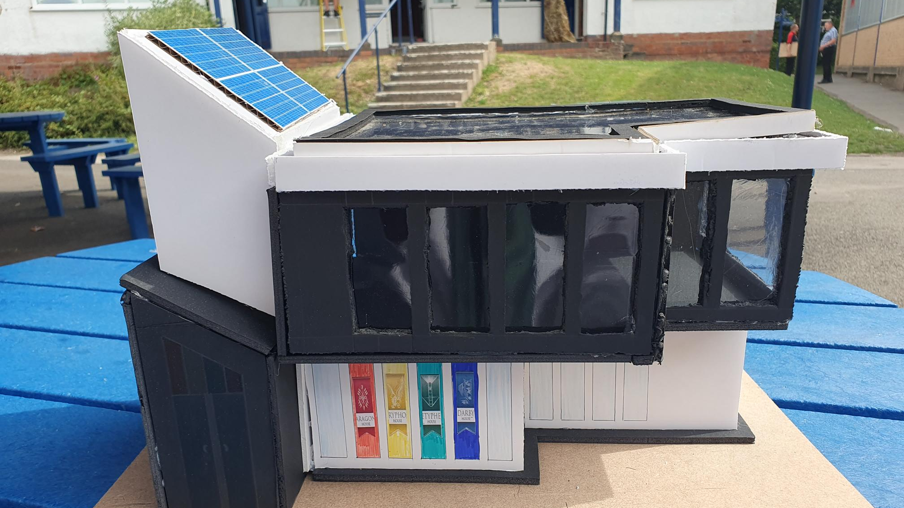
Architectural Model Portfolio
The first thing I will do is identify where my project will be focused on and what it will be and what problem it will solve
Leon Sandhu 12MA

Slide 2
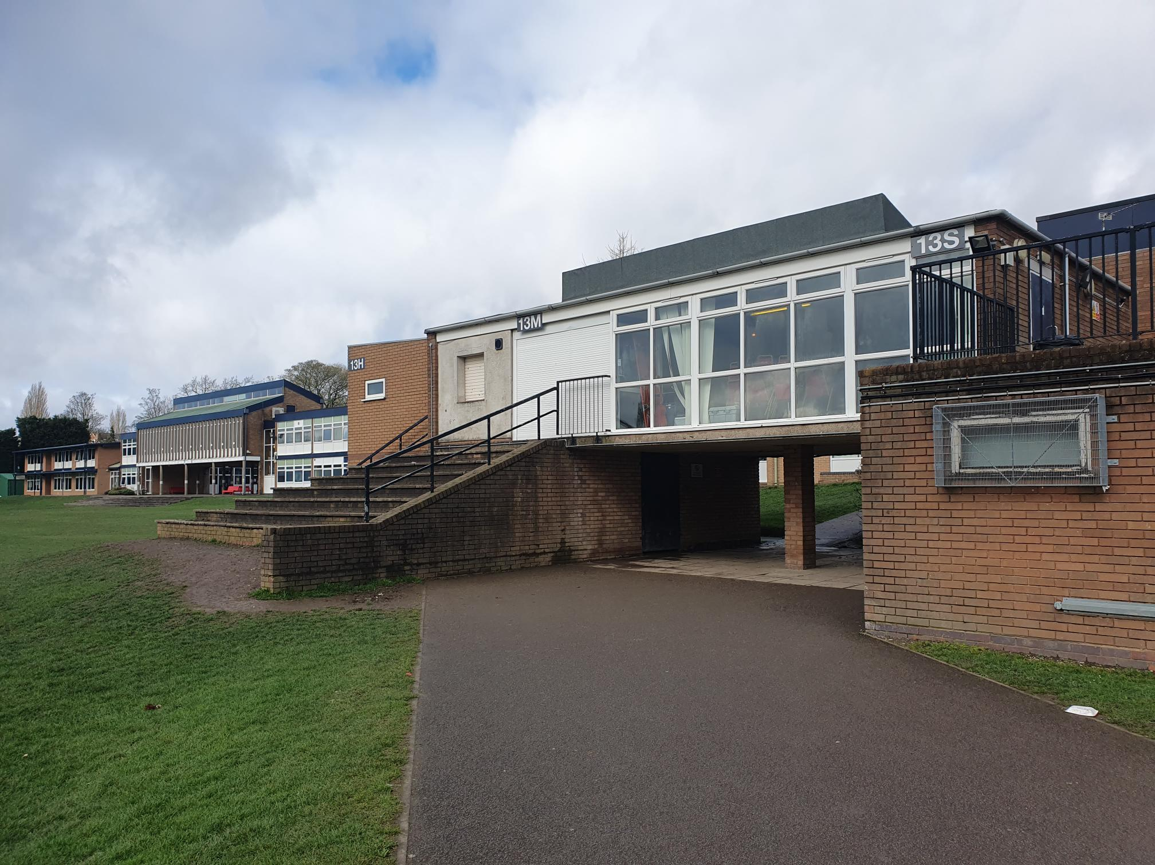
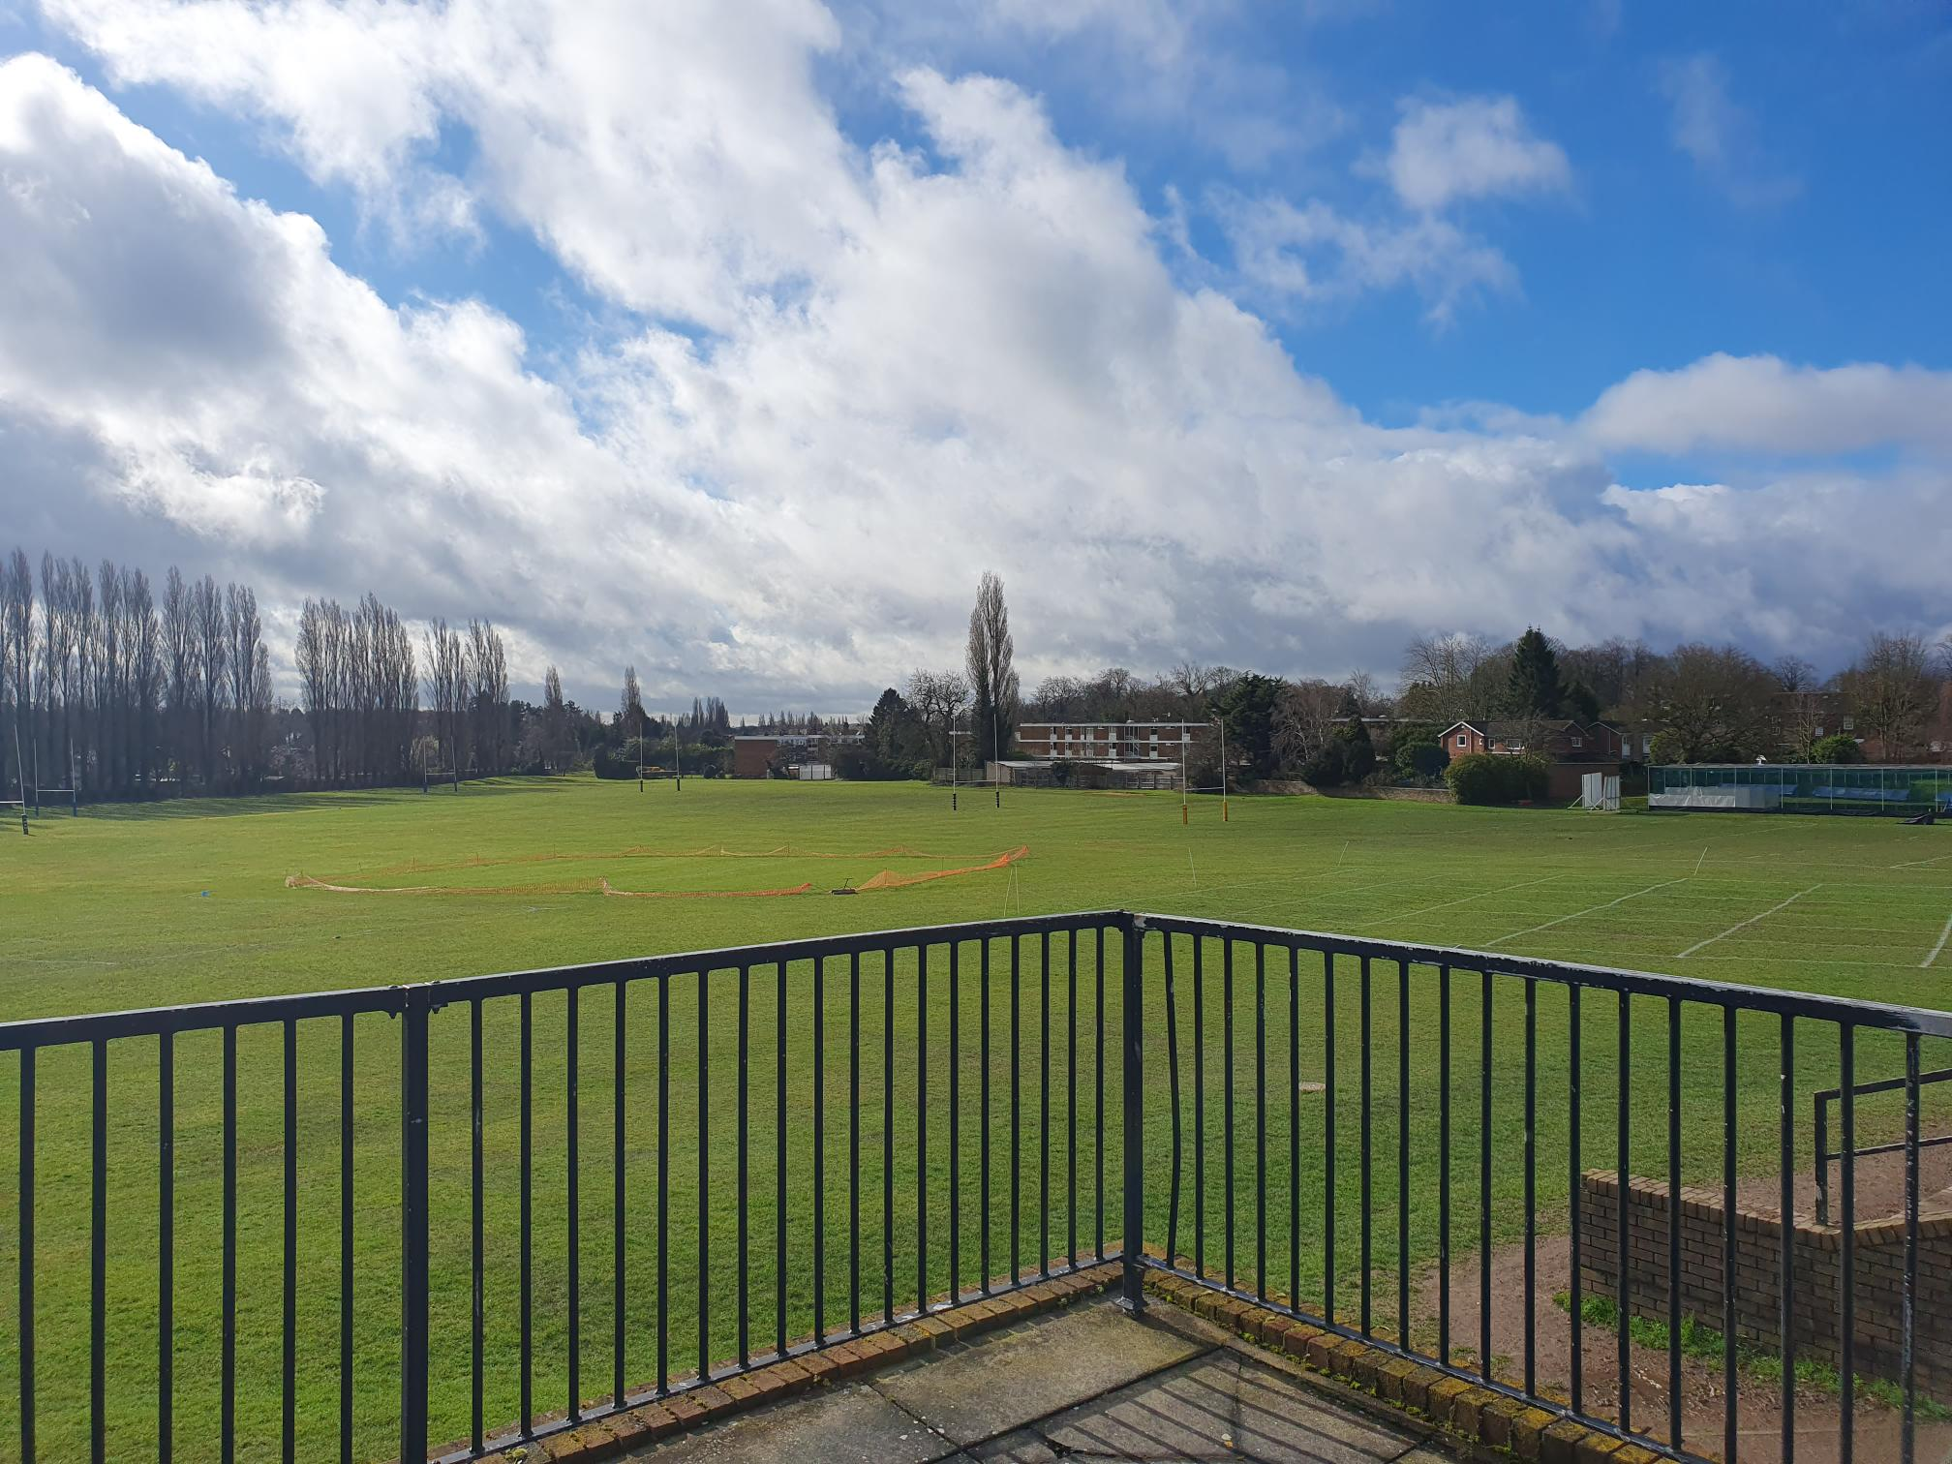
Identifying a problem
The first thing to decide at the start of this project is what problem I will be trying to solve and where it will be located. In terms of the where, I think its logical to choose my school because not only will it be easier to research and design for but also because as a student who has attended since 2017, problems that I identify will be much more accurate and justified as opposed to other problems I would’ve seen in other businesses and organizations. So over the next few slides I will identify a variety of problems that I think the school can work on and come to a decision with which problem or problems I want to solve. I will also create a few sketches both digitally and by hand for some initial changes I would create, when first looking at these kind of problems
Making better use of a space for viewing of sports fixtures and house competitions on the field
This expansion is perhaps a more smaller quality of life upgrade of the current facility by the steps near to the sports store room where there is a building of some sort that in the 6 years ive been here has never been used and if it has, it clearly hasn’t been used enough to justify being there. And as someone who has done PE and Games for 5 years, whenever your playing any type of fixture or house competition that the school runs, the rest of the staff or students who are just watching have always ended up just sitting on these steps which can be uncomfortable and unprotected from any form of bad weather. So my idea would be to renovate this building into making it into to a state of the art viewing area that becomes an amazing feature of the school that makes other schools envious and perhaps more likely to come and play there. This could also involve an expansion to the sports store room that is perhaps more organised and clean because it can be that much bigger, as well as providing a more aesthetic look to the school as an added bonus

Slide 3
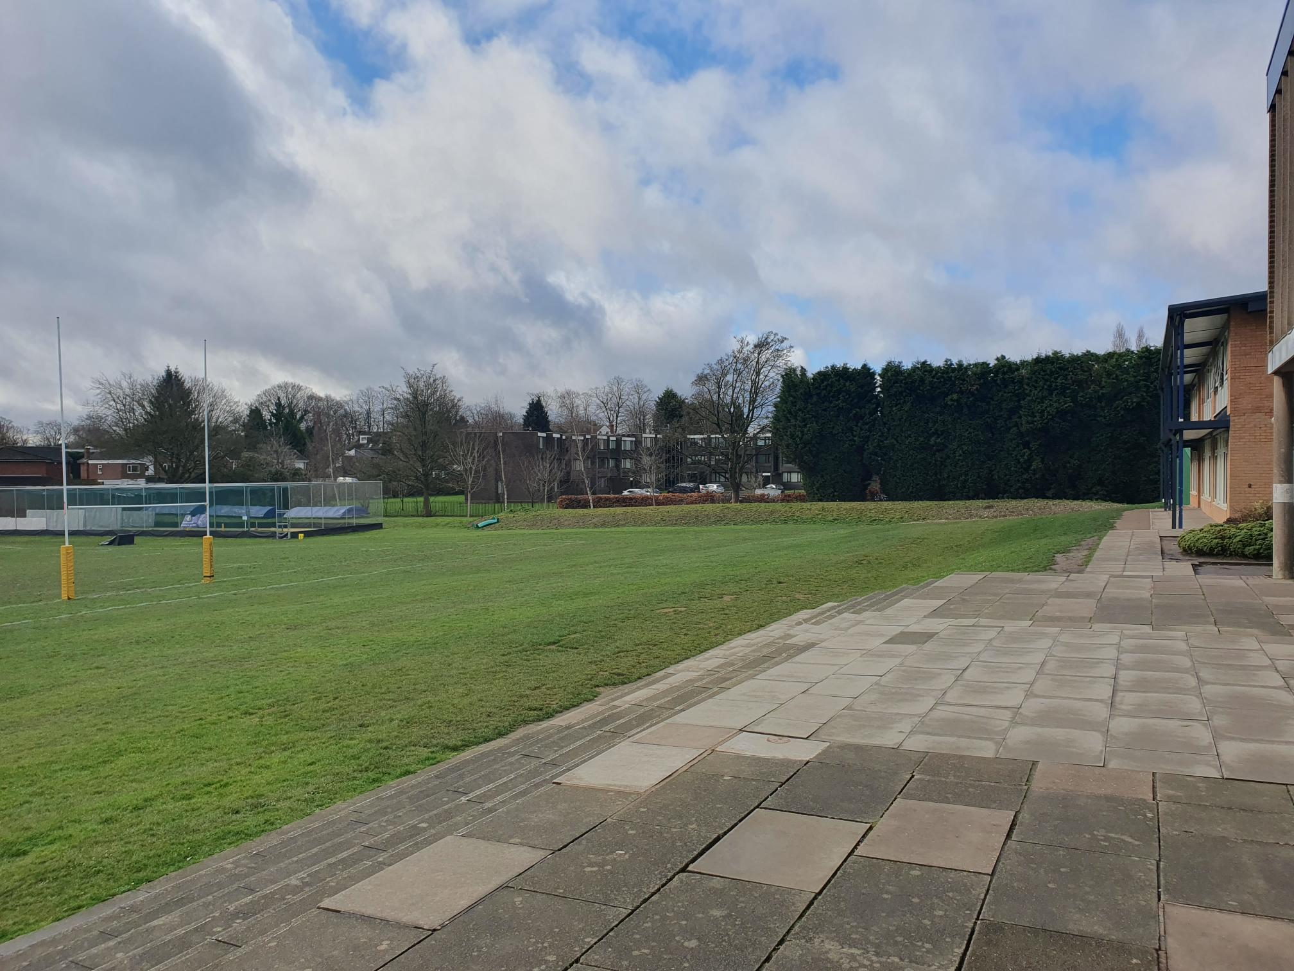
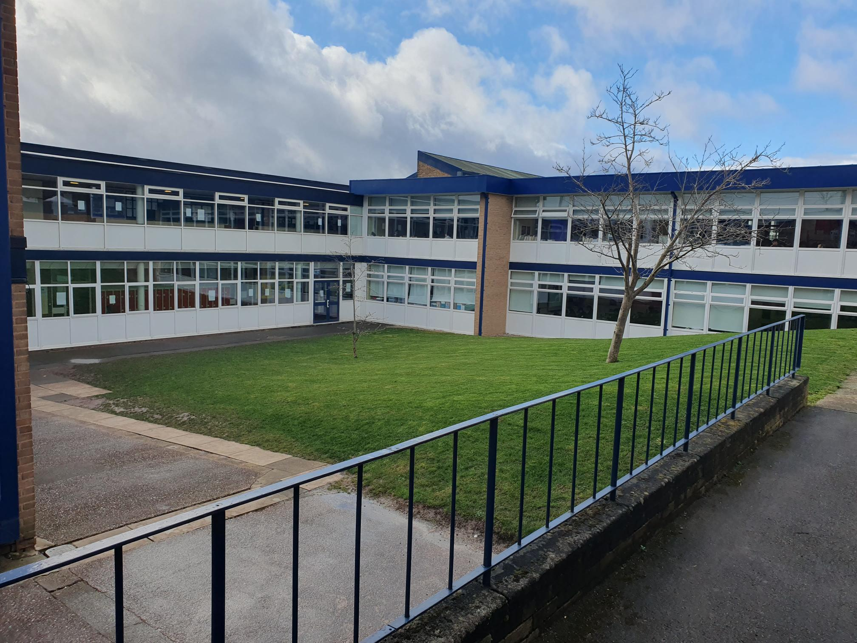
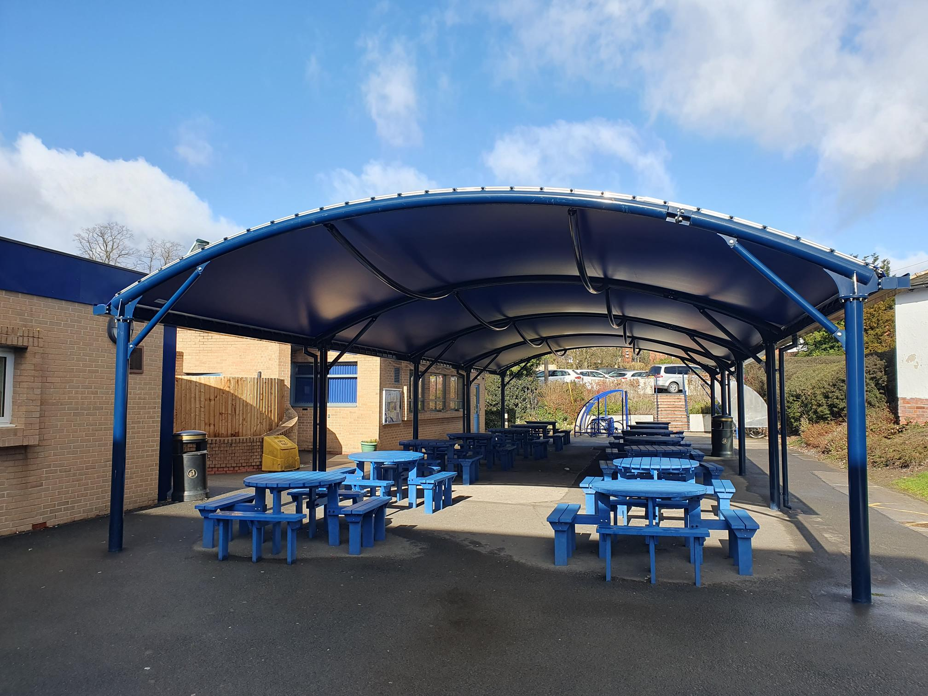
Utilising more of the space on the school field for indoor/protected from the weather activities
For this kind of expansion there is a lot of space on the field that can be used for something like this and I think there is a perfect space in-between the new humanities block and the cricket nets. Ive chosen this space in particular as when the field is in use it’s the one space on the field in particular that I notice goes unused quite often when playing football or anything else, either because of the likelihood of footballs flying over fence if people play too close or just because its slightly ‘closed off’ in comparison to other parts on the school field with the position of the two buildings/structures either side of it. The type of building that could go here could be something similar to the cricket nets in the sense of its essentially a cage with the facility inside of it as to provide protection when objects will inevitably hit it. But inside I'm thinking some of a basketball court as its one of the sports that’s starting to grow in popularity so much so that the current space for basketball inside the CPA is often always filled up especially in bad weather where other students will inevitably play football or some other sport as its one of the limited amount of spaces people can go in bad weather and play some form of sport. So my idea would essentially be to build multiple basketball pitches in that part of the school with some sort of covering on top to allow students to be there in the event of bad weather. Now of course, equipment can be put into place to creates spaces inside the court to play tennis, badminton, dodgeball etc. as to make it multi-use but the main benefit will come by the fact it frees up other areas of the school and can provide an outdoor space for fixtures or house competitions to take place.
Redesigning and massive expansion to the “covered play area”
When this first was released in the school it initially confused me because all it was, was a group of benches with a big metal frame covering it where you weren’t allowed to run or do anything as it was always enforced that no ball games could happen near it. This idea of having benches for social spaces is a good idea so I would keep it, and maybe expand it or have a new different coloured set in the space enclosed by corridors, maths room and the DT department were there is grass that is always trodden on and offers nothing to the school. In terms of an actual “covered play area” it has to go in an area where there is less classrooms so I would go for near to the front of the school using the field at the front. It should look really classy and something to be proud of as it’s the first thing you'll see when coming down the drive, almost like the “image of the school”. It could have multiple layers (potentially one for each type of sport for a massive expansion). This could be shared with the Girls school as a joint facility that out-shines all the rest in the county and be a focal point to attract new students into the school.

Slide 4
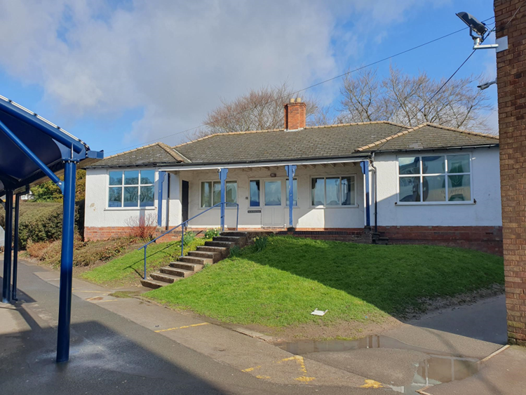
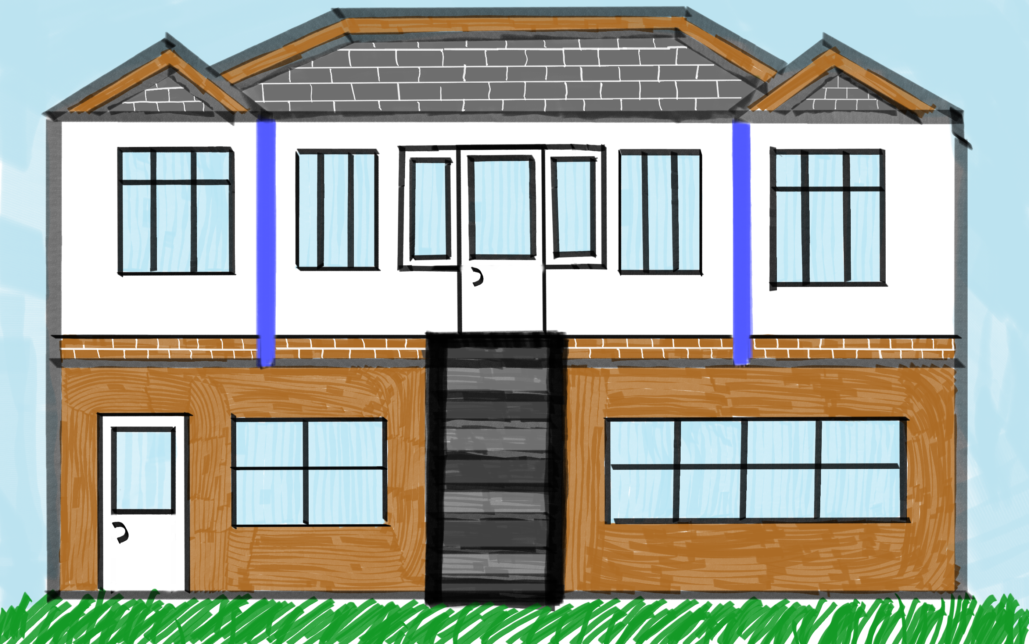
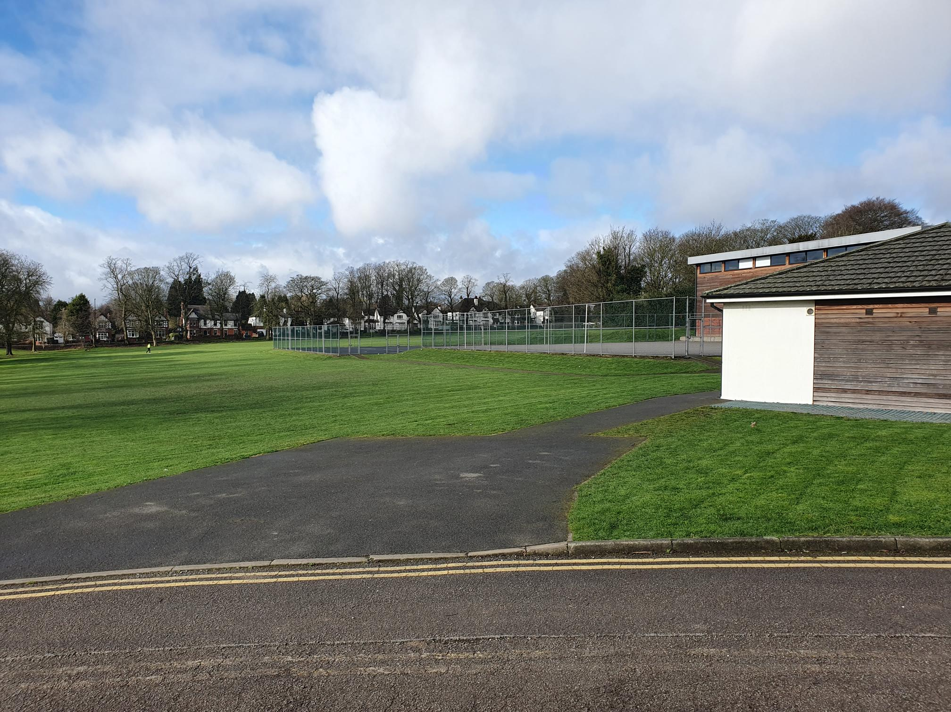
Upgrading the JD room
The Combined Cadet Force has become a massive part of school life at QM and having been involved for 3 years I think ive seen some problems that can be fixed by expanding the JD room. Now given where its located, on a raised piece of land next to the staff car park, CPA and the covered play there's clearing not much space to work with, but I think removing most of the grass and soil surrounding it whilst widening the path out of school which can get prevent congestion and people falling over, which ive seen many a time in big rushes could overall benefit the rest of the school, whilst improving the CCF itself. Things like having a place to store baggage so it doesn’t have to be left outside in bad weather or rushed back inside lockers before and after parade, or having an expanded or a second shooting range, bringing the CCF store inside, providing more classrooms, screens and projectors for theory lessons or a space for indoor team building exercises can easily be included here, with left over spaces left for even more possibilities. This may require fully knocking it down and rebuilding or removing the grass and upgrading below the main offices but either way it will bring huge benefits to anyone involved.
Creating a new space for food tech
Food Tech was replaced when I was lower down in the school by the welfare hub, and although this is a positive move from the school that may benefit students who are struggling with mental health and having a school hub for student welfare and first aid is beneficial in its own right, I think it took away a rather unique but incredibly important part of the school that was creative, educational, fun and taught students responsibility and life skills all in one activity. It was always something to look forward to earlier in the year because of how much students can get out of it. I, myself only got the chance to do it once in Year 7 before the whole idea and concept was scrapped. And although the main body of the school is quite congested with buildings and structures especially with the latest inclusions of the Sixth Form Amex and the covered play area which takes up a lot of the potential space that could’ve been used for this kind of thing, you could potentially used up some of the space on the vast school field or perhaps at the front of the school near reception

Slide 5
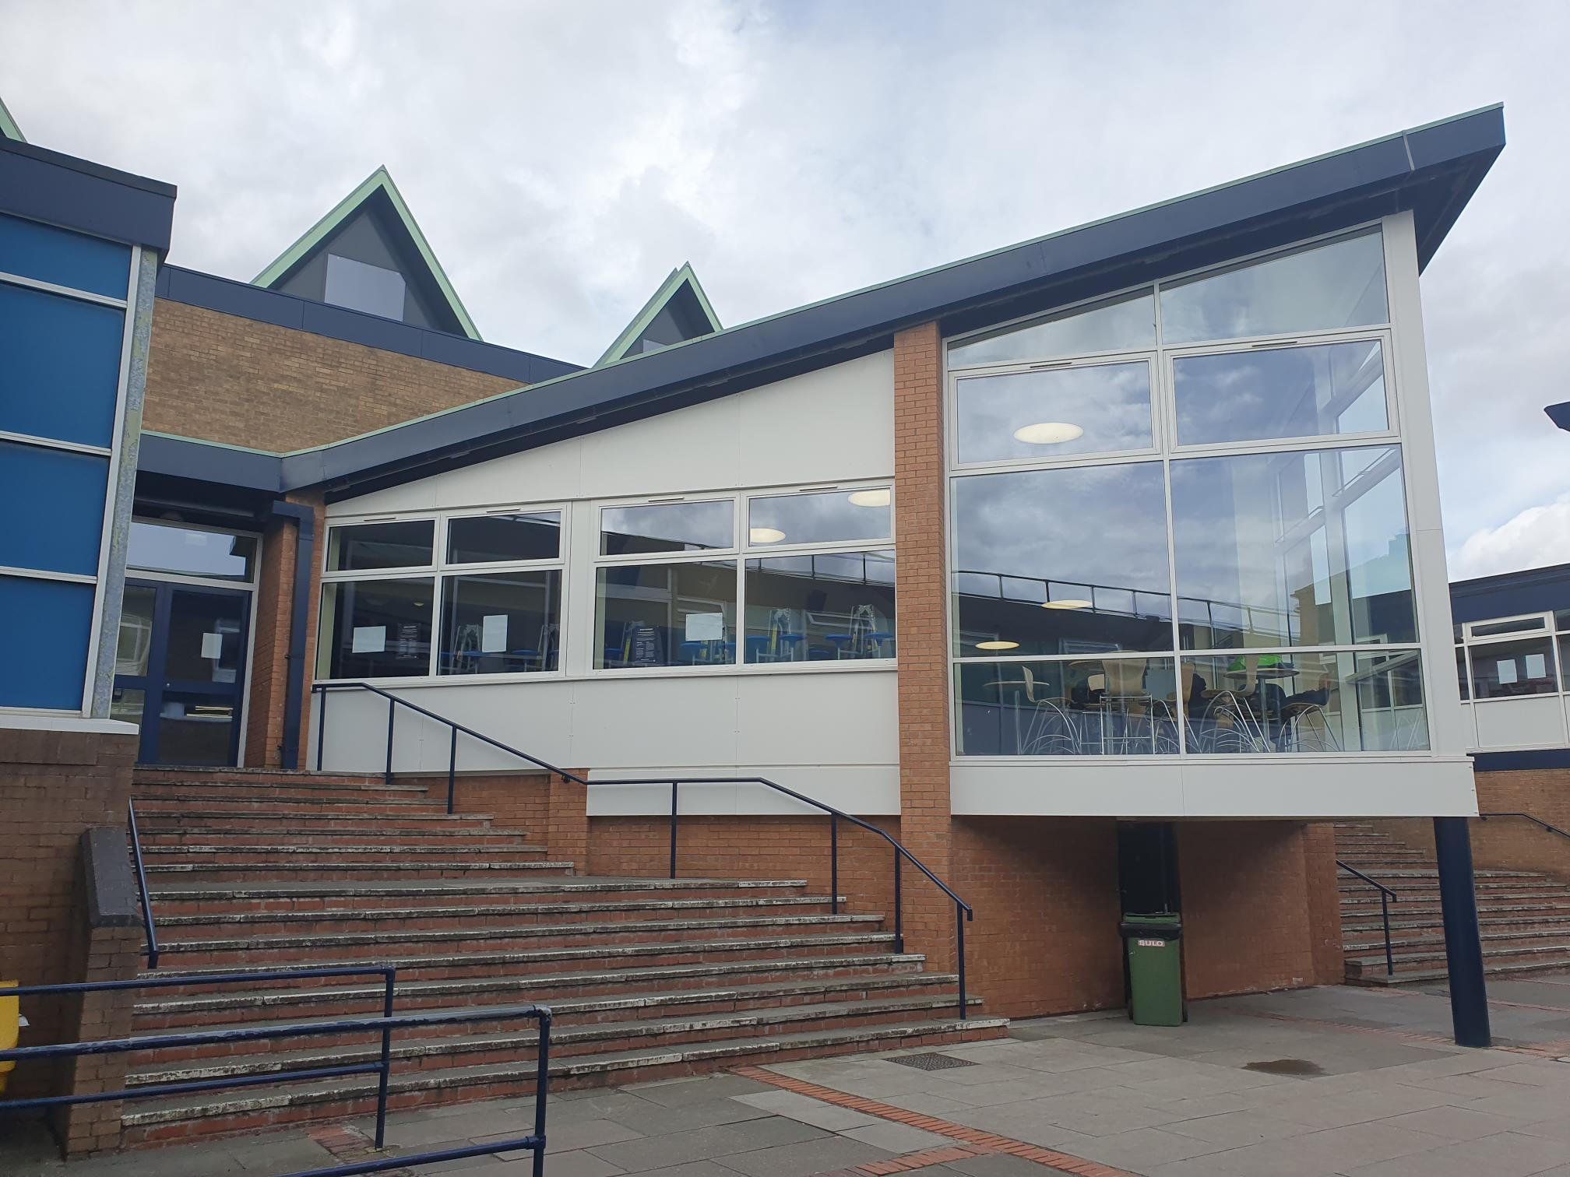
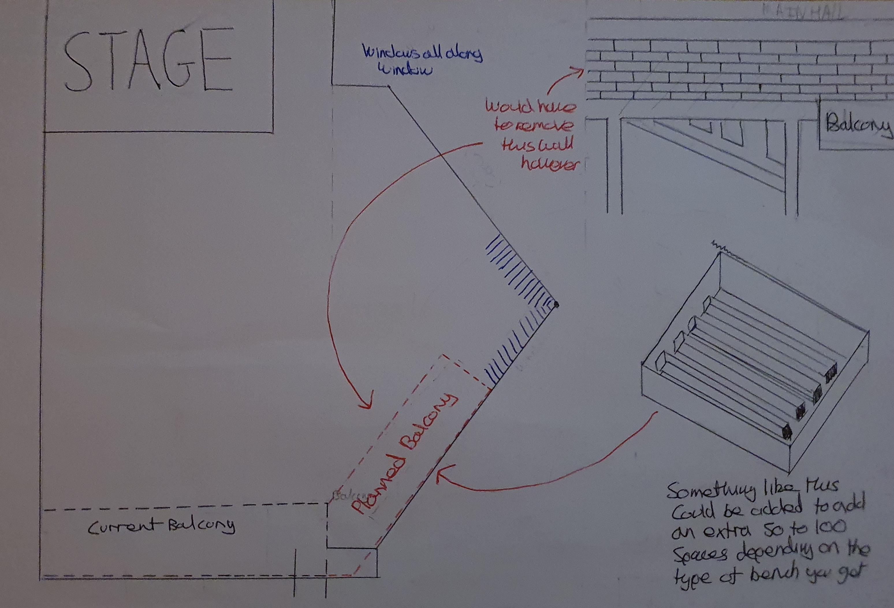
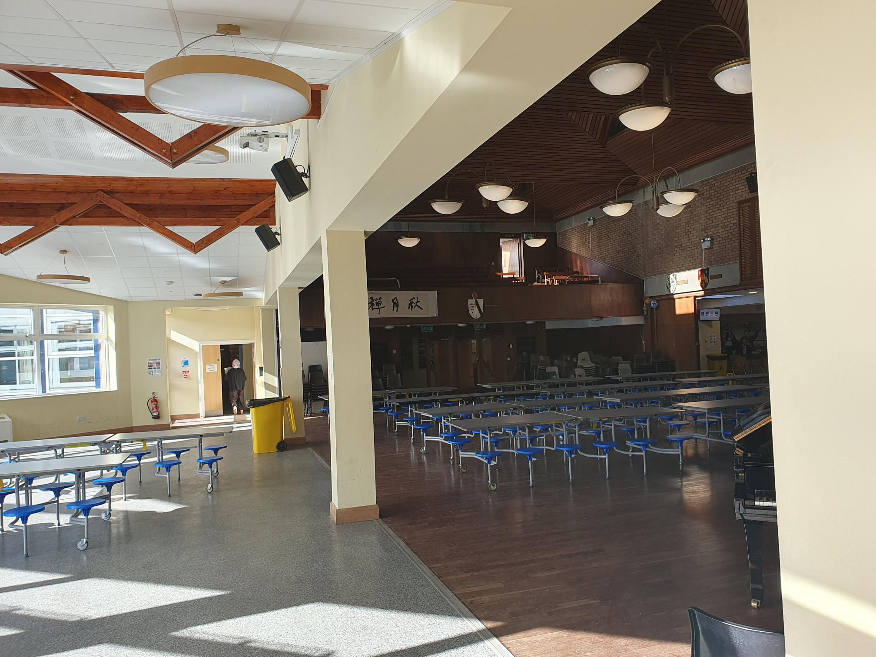
Expansion to canteen/main hall area
When I first came to this school I don’t think this was much of a problem because the school was much smaller in terms of amount of students and staff but now as the school has grown and taken in hundreds of extra students and dozens of new staff I definitely think this is the kind of upgrade that needs to happen as soon as possible because even with many sixth formers going out at lunch, when the field is out of bounds this area can get very congested not only at lunch but even with assemblies. For example, even with the triangular expansion that the hall has had we still wouldn’t be able to fit everyone in if we wanted to return to whole school assemblies. So, I would propose a second floor/layer being added onto this area which could also indirectly expand the kitchens and reception, while keeping the front “face” of the school looking as aesthetically pleasing and attractive as possible. This type of expansion would be huge to the school and would free up congestion and queuing dramatically. The improvements in kitchen quality as well with an expansion to what they offer could see more sixth formers decide to stay in for lunch as well which can only be a positive for the profits the school and kitchen staff turnover in the future.

Slide 6
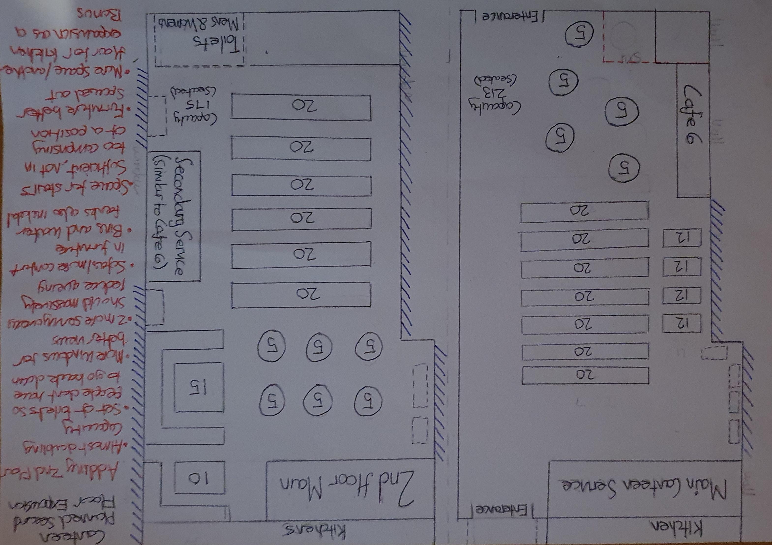
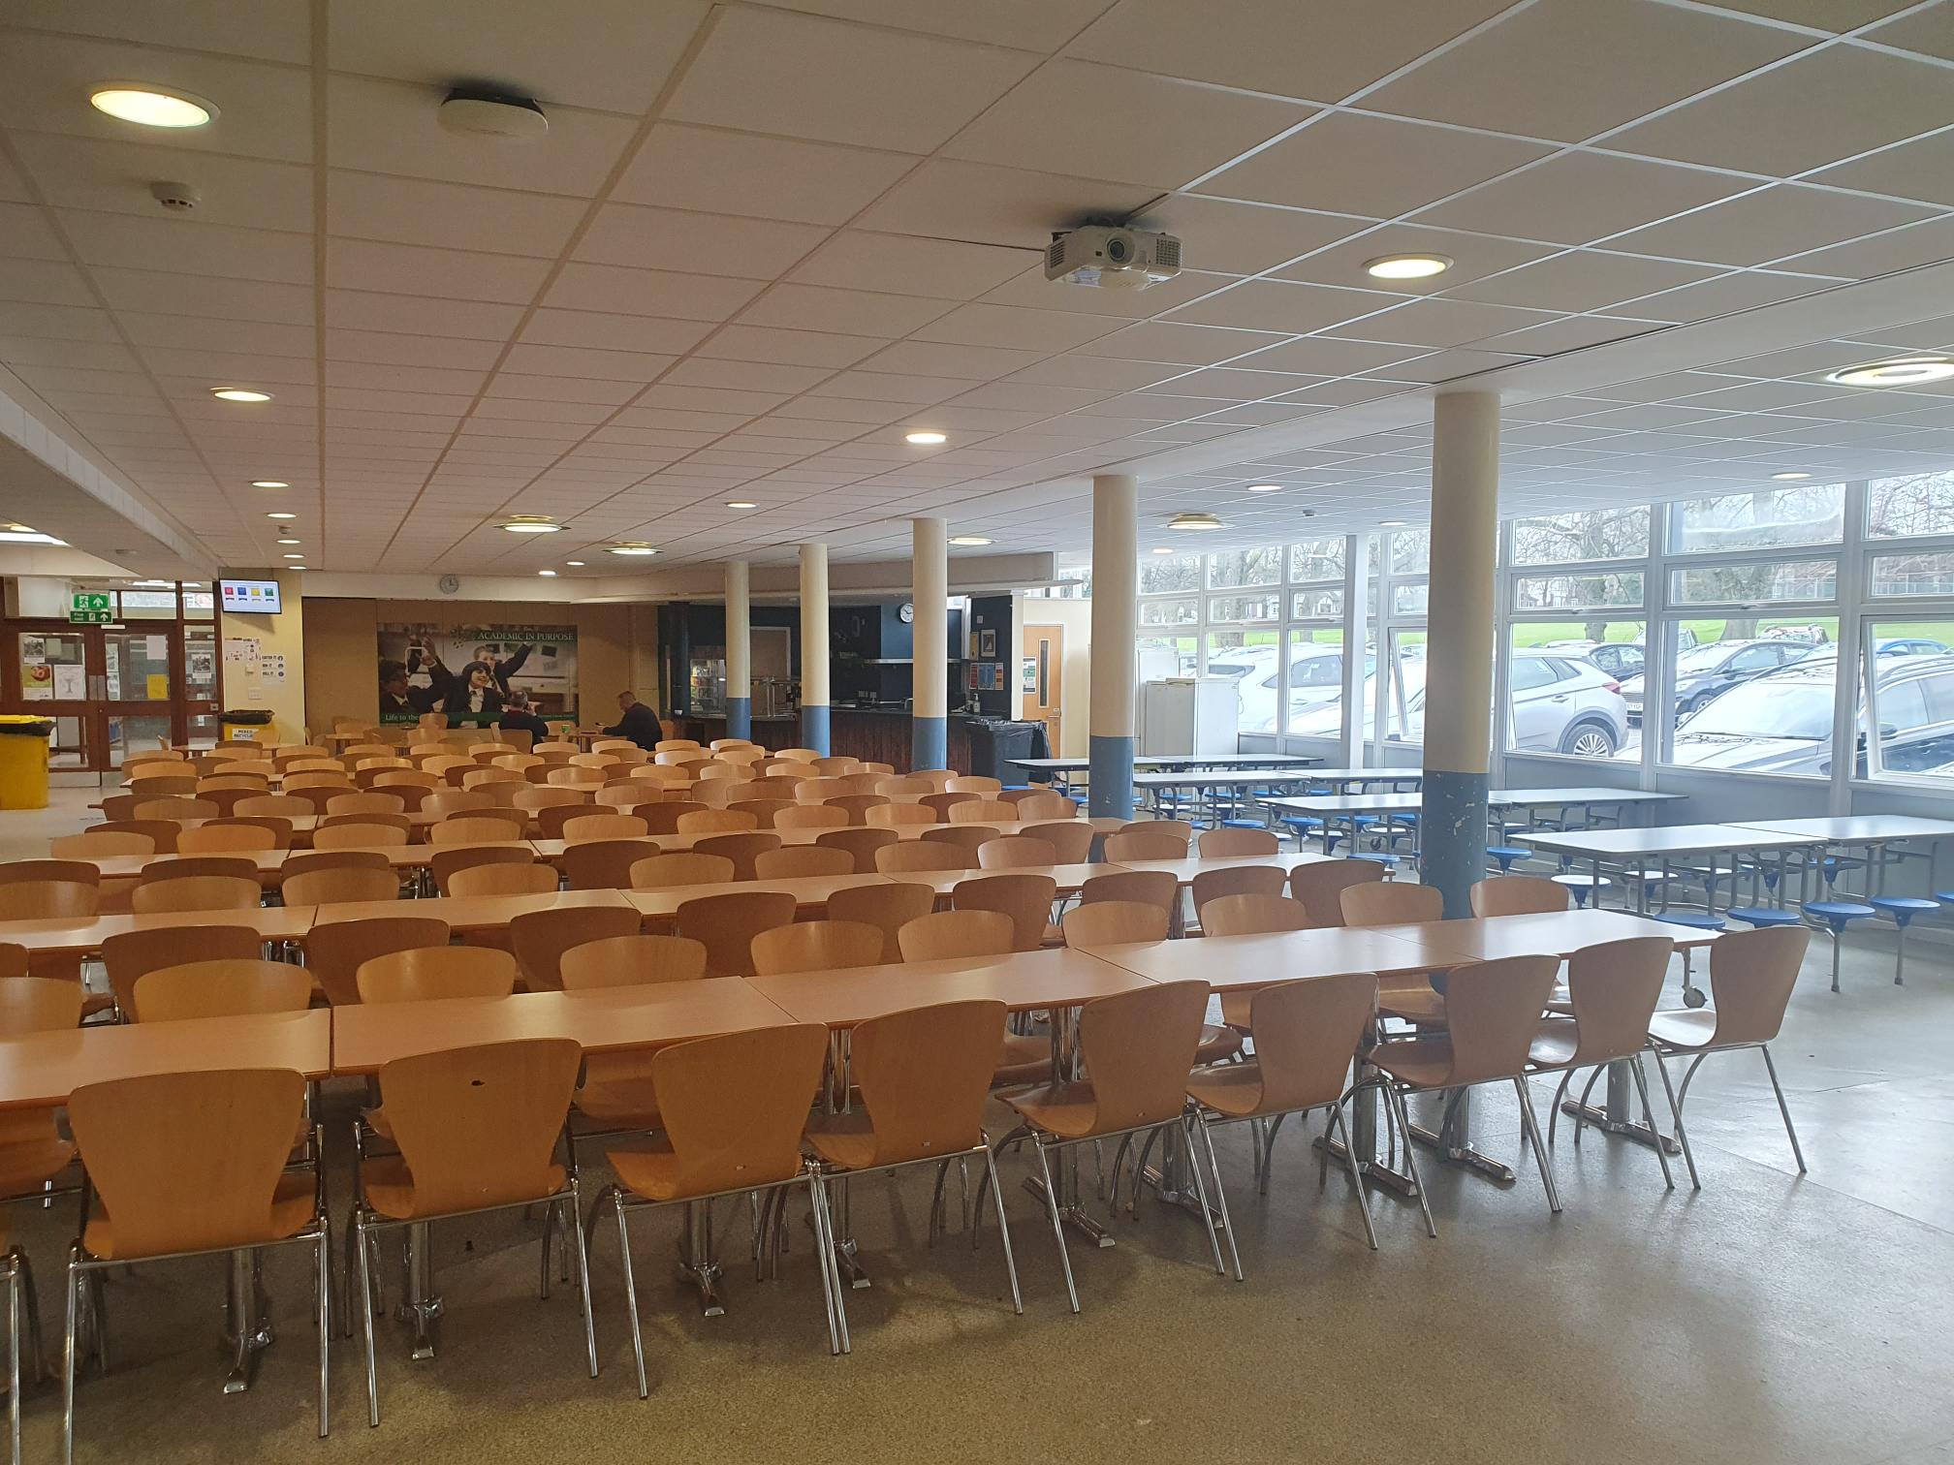
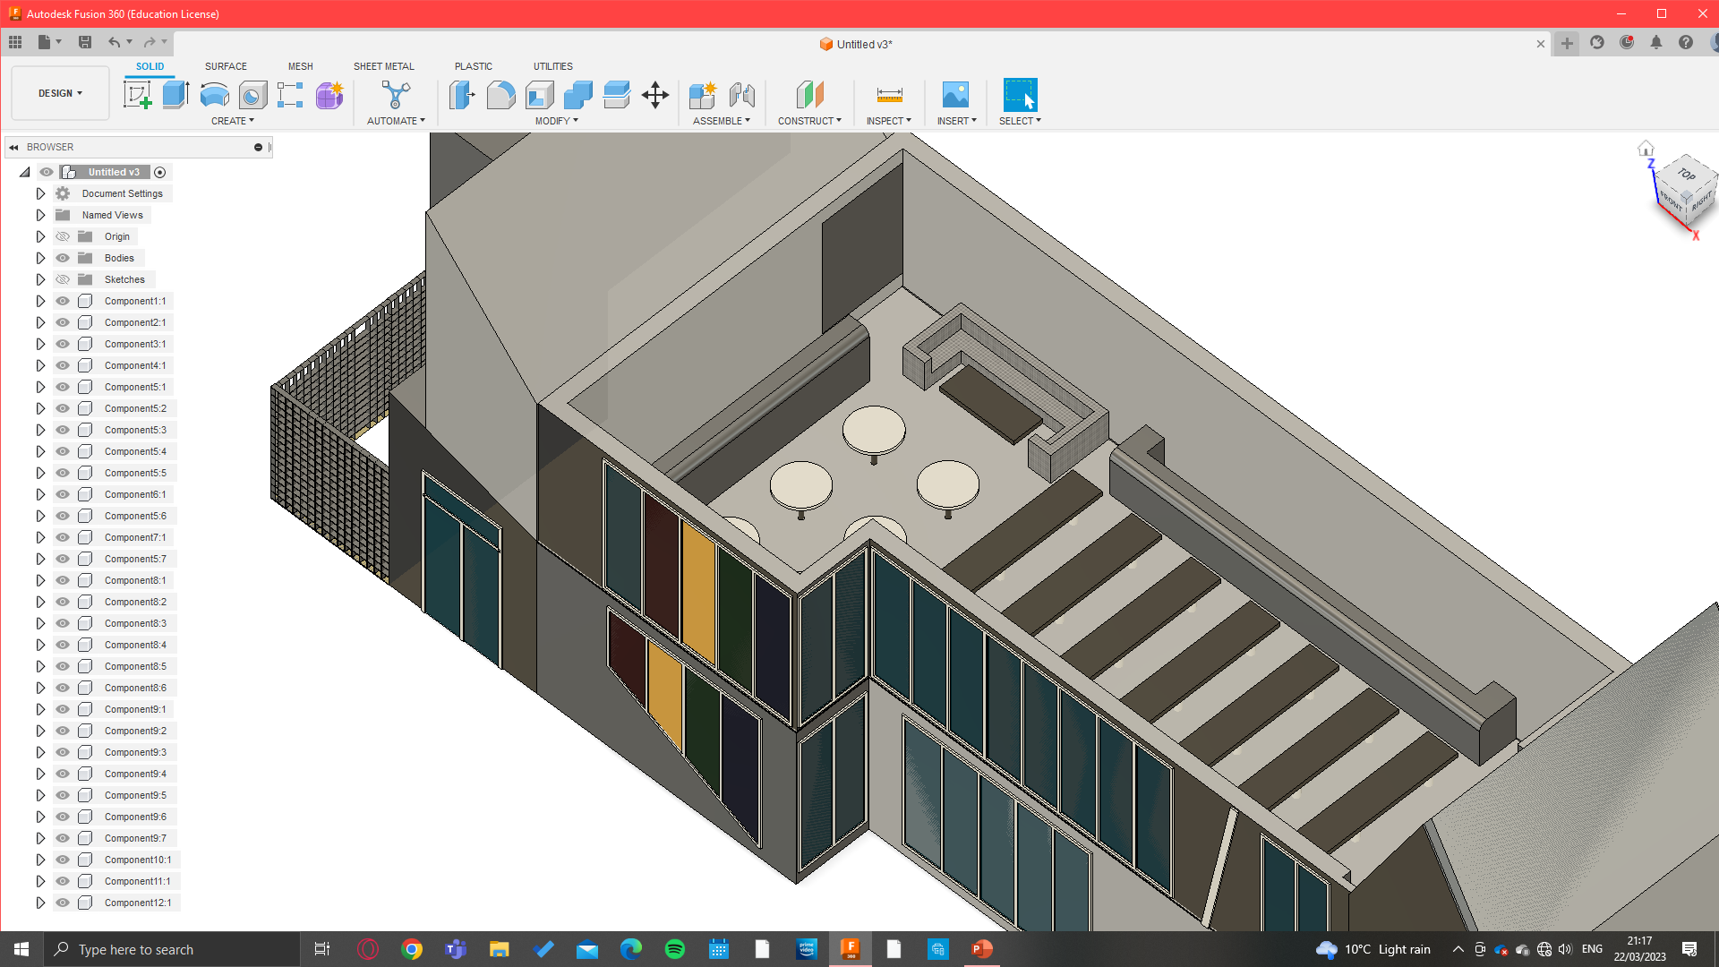
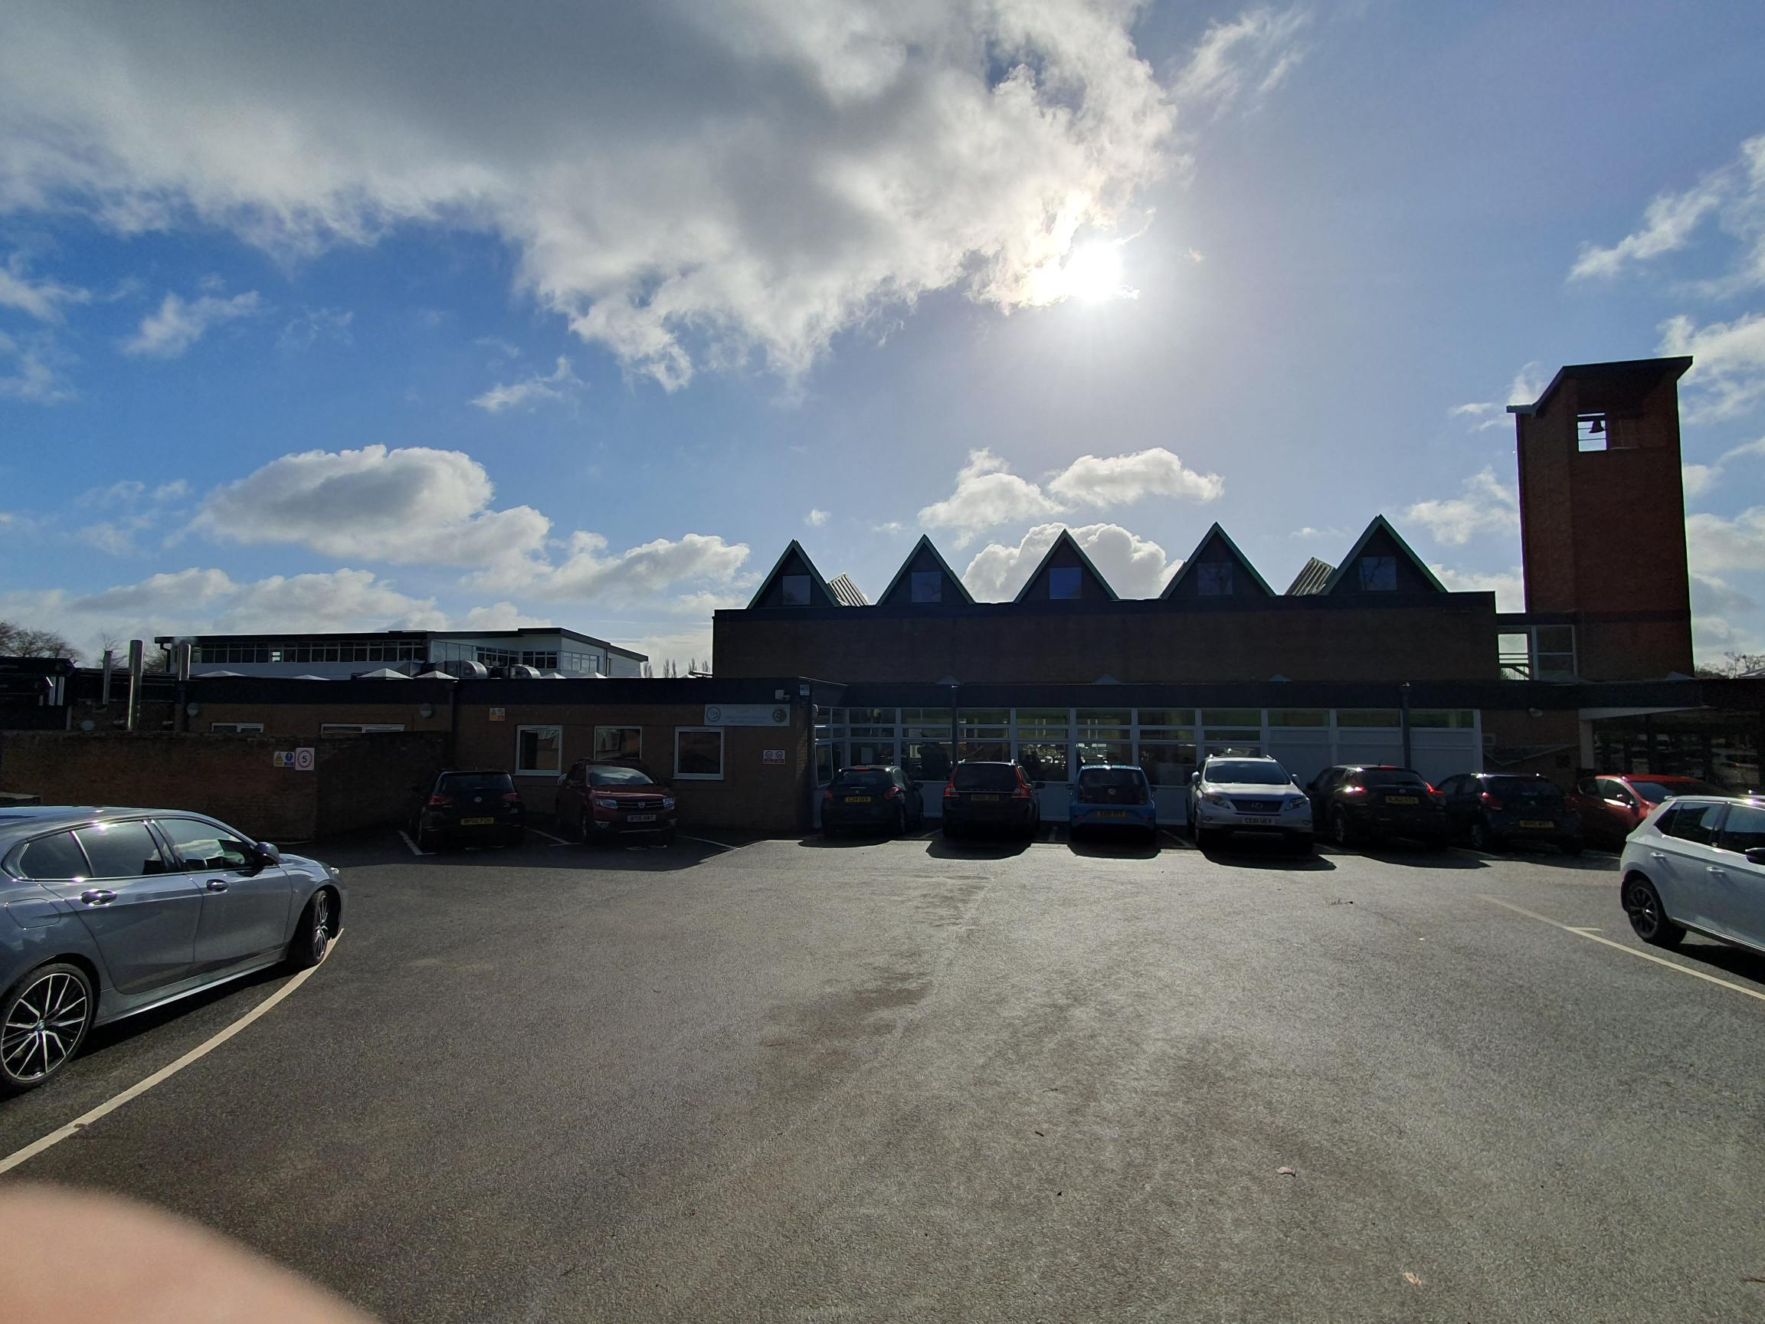
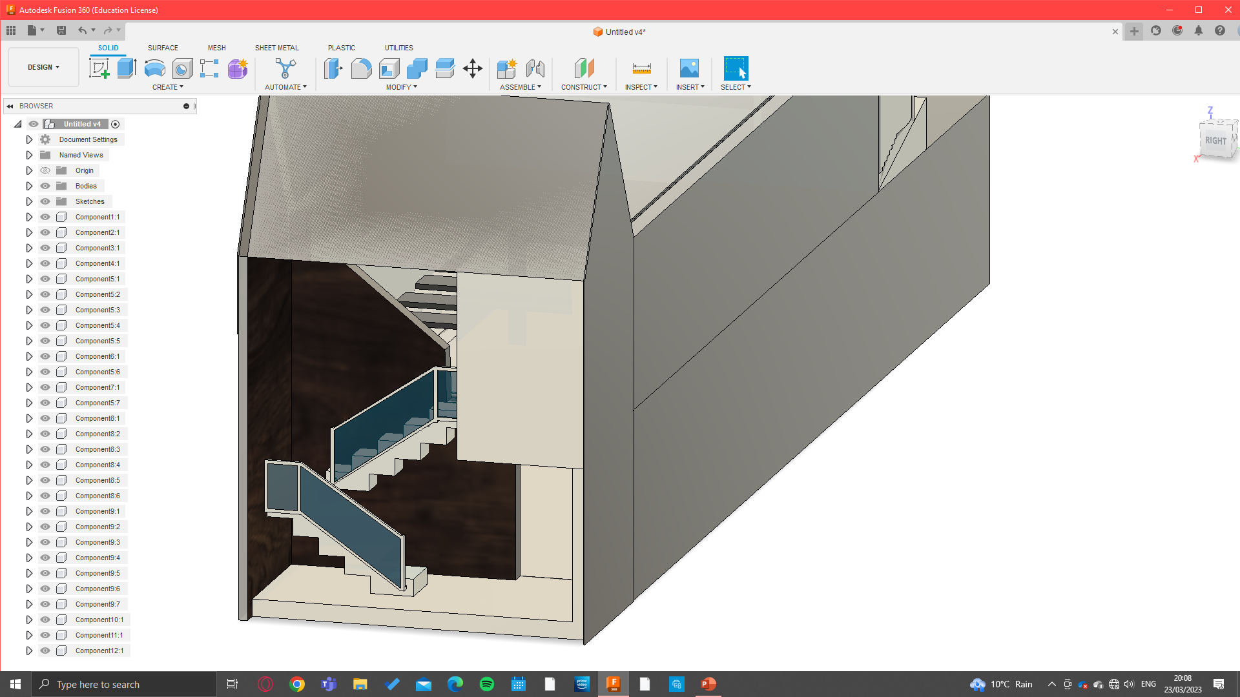
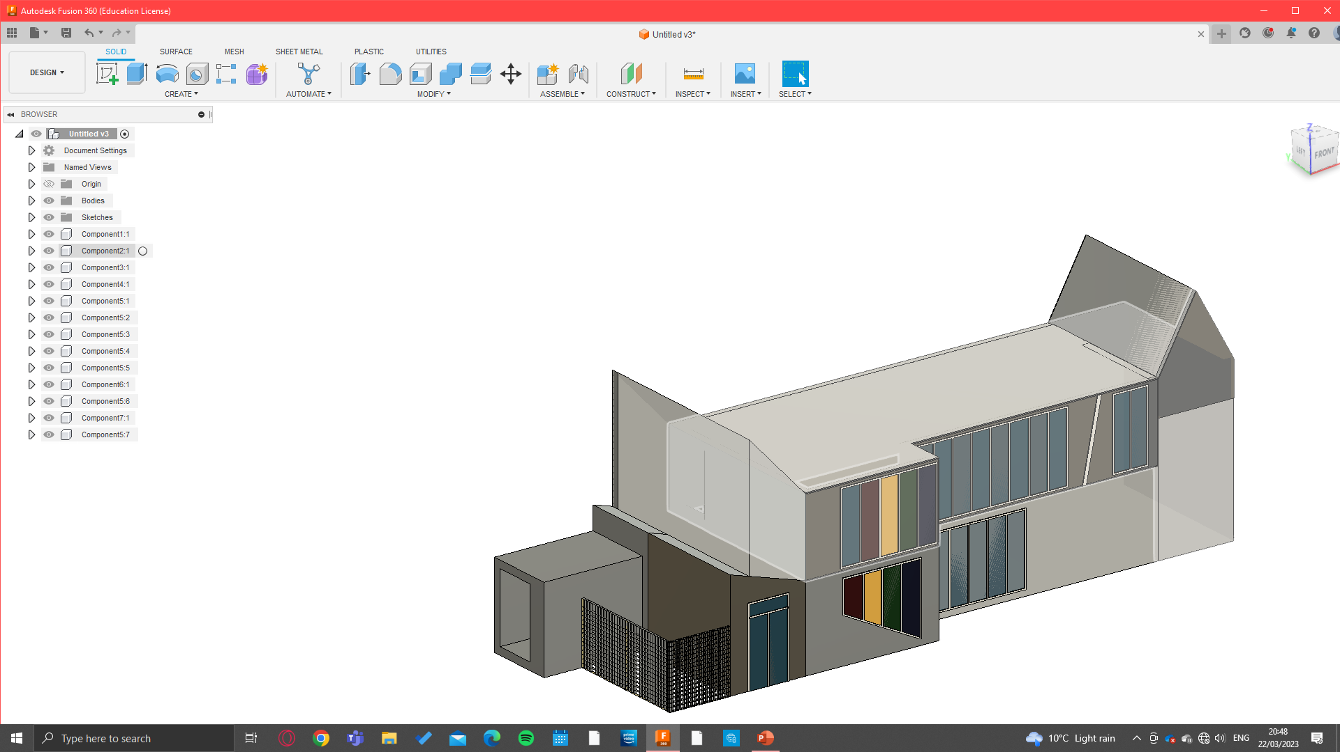
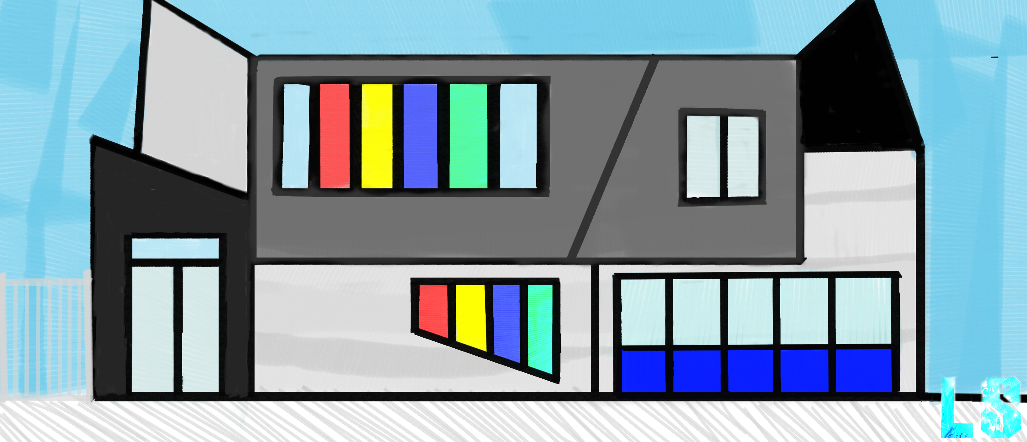
After reviewing these many changes to the school I've decided against doing multiple mini expansions like I originally planned and instead want to continue with one larger upgrade that could really benefit the school as I think it would have a bigger impact in both the short and long term of the school, so my chosen problem will be trying to upgrade the school canteen. I decided against including the main hall in this expansion, mainly because if the shape of the roof in the hall being to intricate to make any massive change effective and because moving the honours board which is almost iconic may cause the school to lose a bit too much of its past and may upset the SLT.
Therefore, my proposed changes/solution to problems in the school that I will move forward is just an expansion of the school canteen

Slide 7
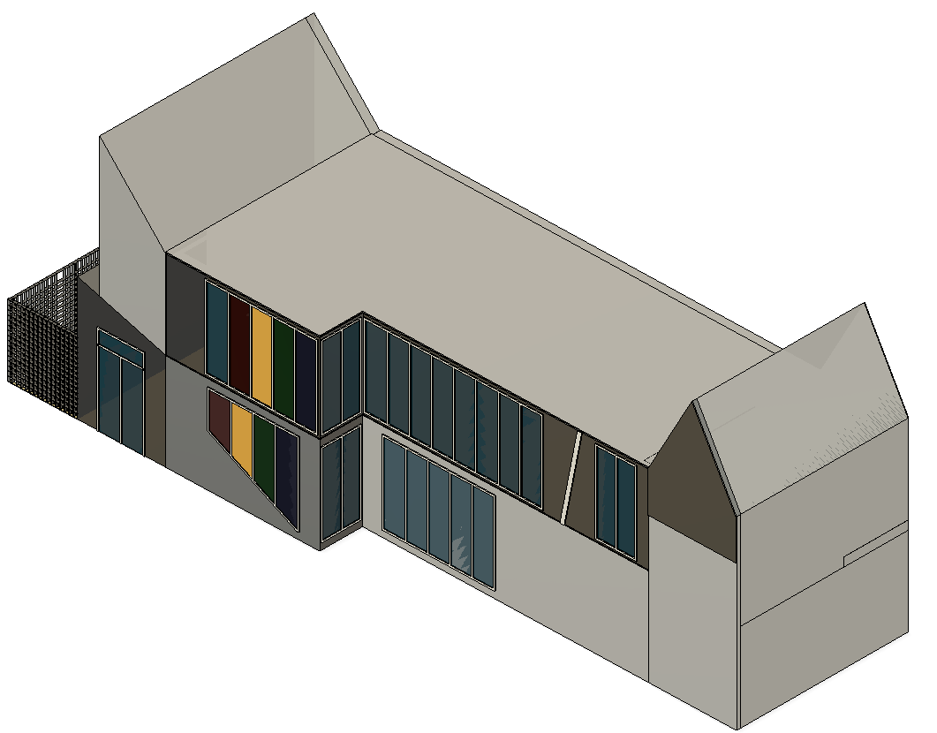
Design Brief
At the start of this mini-project I was given the task with designing a concept model of some sort of building for a client or situation of my choice. Very early on I decided on choosing the school as the place to where my project would be focused around as I have extensive knowledge on it as I have attended for nearly 6 years now, it was easily accessible to research and think about what I might want to do as I should be able to identify some problems within the school better than if it was a business or corporation that I was only visiting for the first time. And so that is exactly what I did. I started to identify many different problems as I could choose within the school and do some sort of initial sketch or plan for each one to give me a rough idea of what might be a bit too unrealistic or too over the top. After some extensive thought ive finally decided to redesign and expand the current school canteen as it's been unchanged since ive attended and could really do with upgrades, not only to make it more modern and appealing but also to help deal with the increasing intake of students that are joining the school as years gone on. It's no secret the school community has dramatically increased in size and this kind of upgrade can be something to help deal with that. My inspiration for the type of canteen I want to design is something that I saw at a local secondary school years ago when I attended on an open day which essentially has 3 layers with glass windows and a general classy futuristic look which was mind-blowing to me when I first saw it and so I want to take ideas from that building that I want my design to achieve. When designing this I will always have to be thinking about the different types of people that are going to be using it as it must be fully inclusive, I need to use the current problems in the current canteen and solve and improve on them in my redesign/addition of a second floor, this can be in terms of spacing between each table, the comfort, the design and the efficiency of the service provided. So, over the next few slides I will identify as many problems/things to improve on in the current canteen as well as my own ideas to create a specification of targets that I will set out to achieve.

Slide 8
Specification
Point | Explanation
Must improve the overall aesthetics of the “front face” of the school with the new canteen expansions both in terms of shapes and colons use | For any kind of expansion that’s at the front of any sort of school, business or organizations it's got to look good because it will give new people that are coming in, whether its new students, staff or even just visitors it will give them a first impression of what the school Is about and therefore it's got to look as good as it possibly can be
Must also improve the quality and aesthetics of the internal furniture to bring it more in line with modern and stylish furniture and facilities | With a more modern stylish approach on the “face” of the expansion it doesn’t make sense to not improve the overall aesthetics of the interior to better suit the school moving forward
Must be suited to the school, be able to hold future capacities of students and cater for every type of person | Very important to be all inclusive in something as diverse as a school, so in the design it's important to think about different types of people, different sizes, people with disabilities or other kinds of difficulties
Although there would be no sort of set “budget” as such its almost important to try to minimise costs not only for financial reasons but also to make things more profitable | Any sort of expansion for the school would have to be financially viable so cost must be kept to an absolute minimum
Any sort of environmental issues should be avoided and maybe should try to think about using sustainable energy sources like placing solar panels on the roof of the extension and use the energy from that for the running of the extension and maybe other parts of the school | Nothing can be done in the modern age without considering impacts on the environment whether it's through sourcing materials, building the actual structure or replacing any damaged parts and its after life cycle so all these things must be considered when choosing certain materials or types of furniture
The size of the expansion can only cover the same sort of area it already does because there simply isn’t any more space to do anything else so any expansion must be an additional floor | Avoids excess money and hassle destroying other buildings. Structure and creating a wider area for a canteen space
All areas that are built in this expansion obviously must be very safe for staff and students to use, things like loose floor planks, electrical wires, structural fragility and any other possible sources of danger must be taken care of | Help to avoid any accidents to any person that uses the new canteen, making the whole area safe to use
The whole space must be able to include hundreds of student capacity and extension to the kitchen/storerooms for food, serving areas and toilet facilities | One of main reasons for this current expansion is that the current canteen is often rammed and full and lunch or break and students are often left having to queue at set times and for longer periods, meaning most sixth formers choose to go out for lunchtimes
Limit use of crude oil-based plastic or any unsustainable sources of materials but make sue this structure will be able to last the time | It's important to make this whole expansion as sustainable as possible for the better of the school community and environment so things like this must be considered

Slide 9
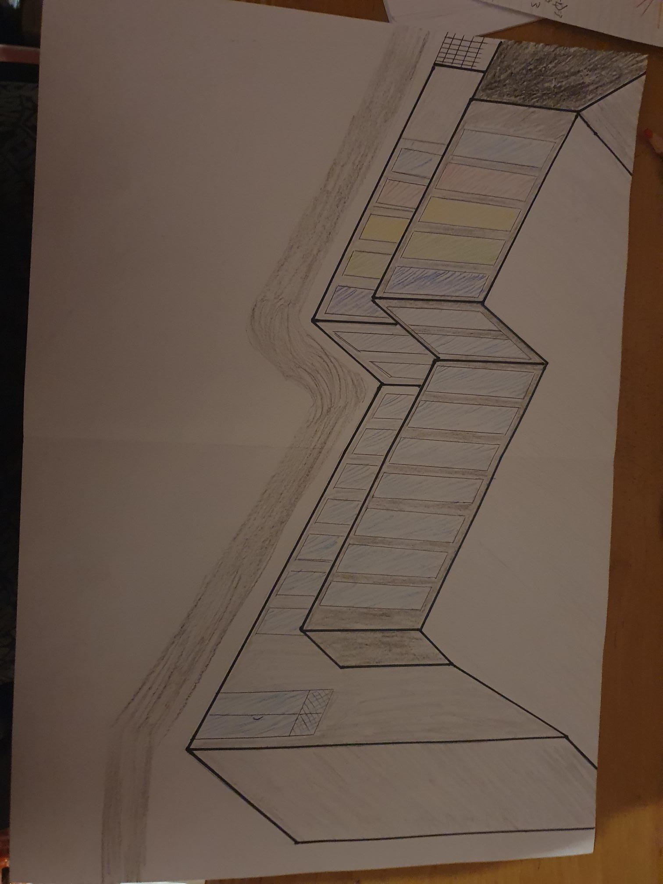
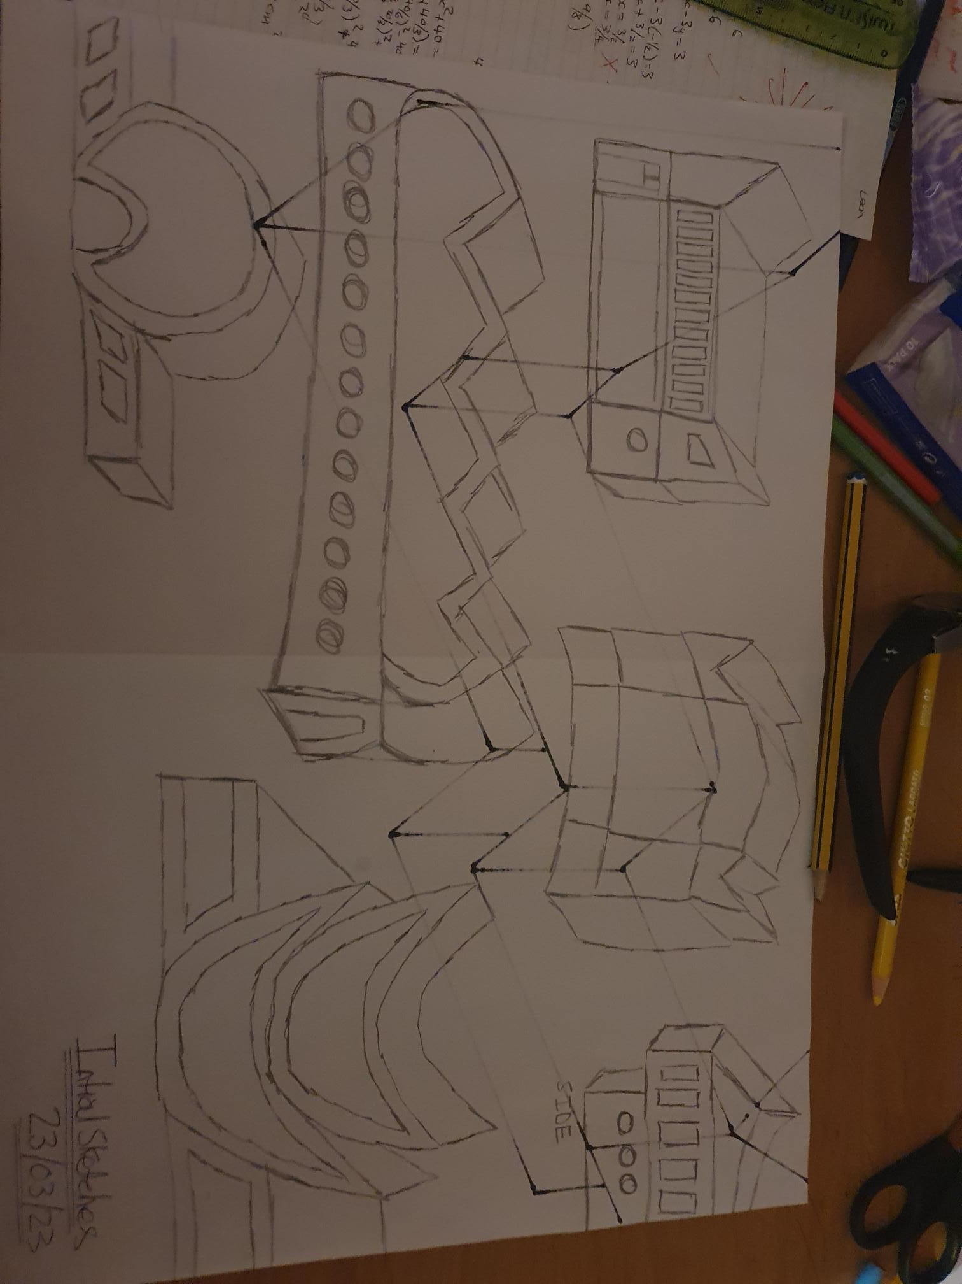
Sketches of chosen idea
Now that ive decided what I will be modelling and have written a design brief and specification, I can closely follow it when creating more sketches in order to design the most accurate layout of how it will be built in my head.
Of all the designs beneath I do like the extravagant one towards the bottom left because it's very futuristic and attractive in my opinion but unfortunately it would be too unrealistic in the place it would be located because of the sheer size of the front “dome” area. So, because of this I chose I progress with the top left design because out of all of them it’s the most realistic and compliments the school better than the others particularly the bottom left one, so I decided to draw a much larger slightly adapted version of it on the flip side of the paper
Although I like the concept, I chose to move forward with I decided to remove the circular windows because I thought square and circle shaped windows together don’t really work. I also chose a tint to a few of the windows to represent the houses of the school to make it fell more QM and I decided to make the top overlap the bottom to give it a Miami beach house feel to it which I think could look good when finished. Obviously, I must think about the weight distribution here when I'm designed it, but this could be easily managed. I also wanted to walls of the building to be different colours as to not make it too boring and unappealing so I've chosen shades of black and grey which I think will complement each other very well. Overall I'm quite happy with this solution as it also quite importantly hits a lot of the critical and important points from my specification which had to be a main target of this project. So, on the next slide I will design a final solution to this model.

Slide 10
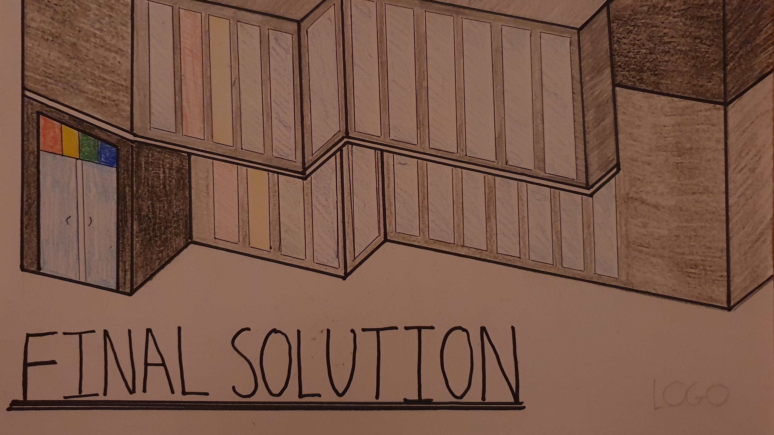

Slide 11
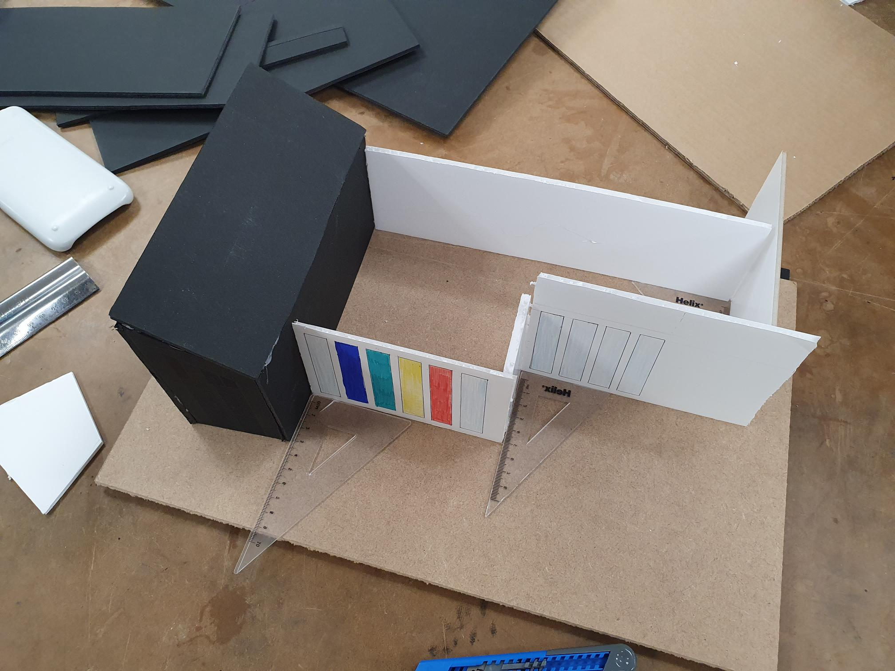
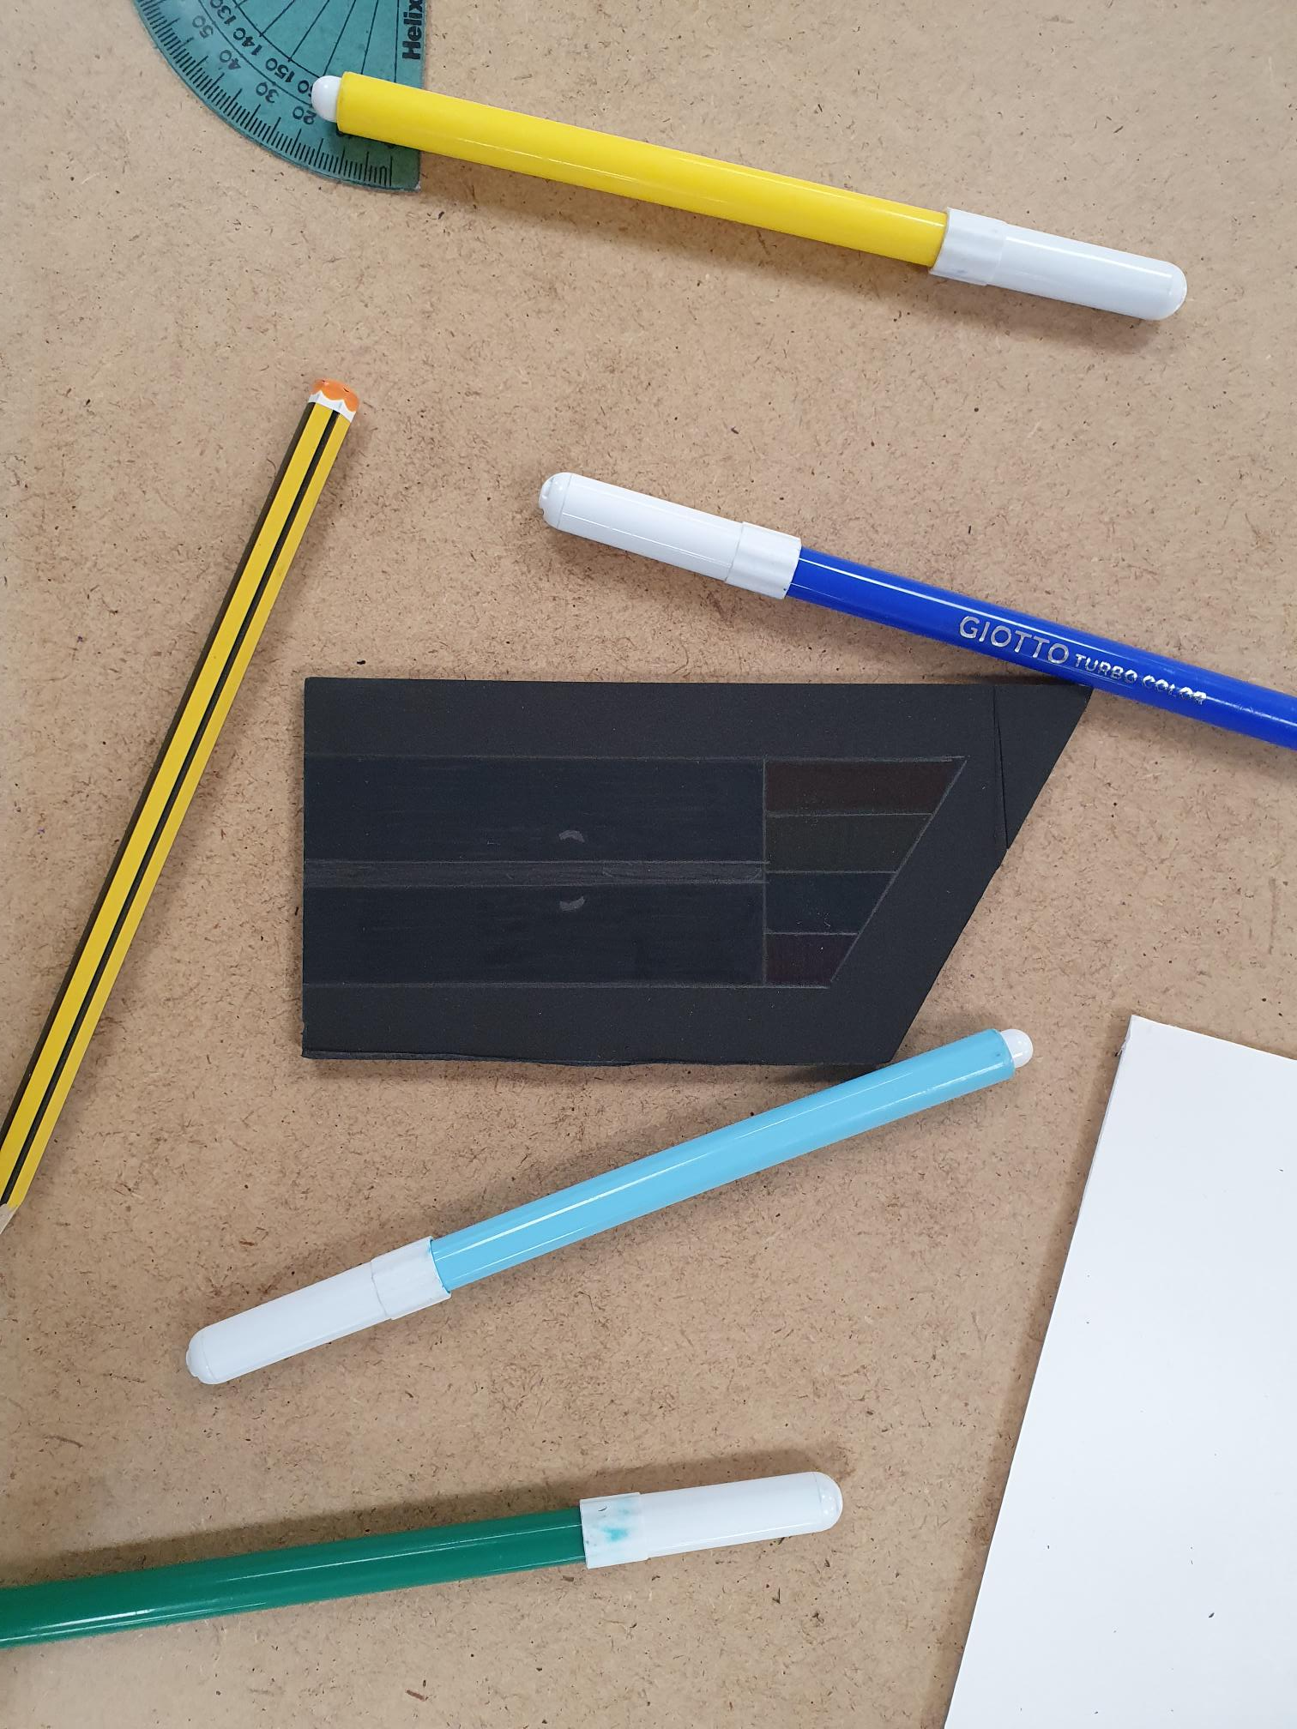
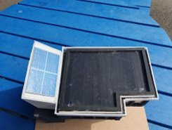
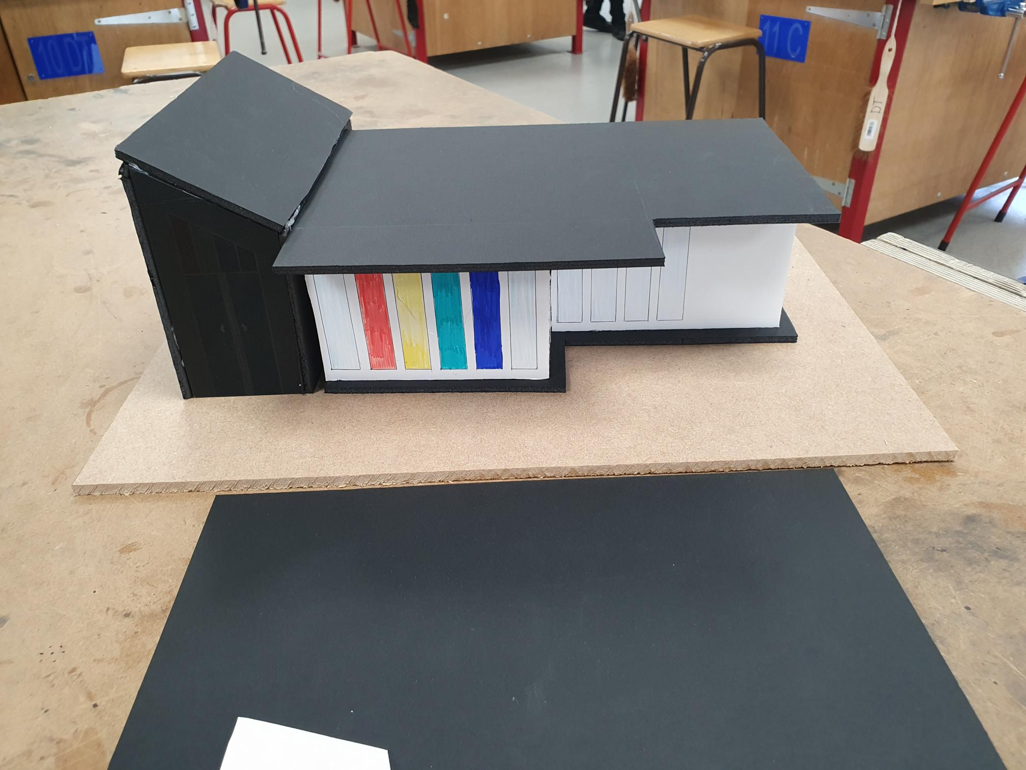

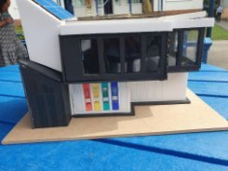
Manufacturing Solution
Now that ive decided on a final solution it's time to start building a prototype. The task was designed to use foamboard predominately as a main material with other materials like acrylic or MDF should be minimalised. After this I evaluated my design and decided that all the walls would be foamboard based with the inclusion of a clear, transparent materials as a potential glass roof or windows. I potentially could add solar panels that can be 3D printed as a bonus should there be quick progression with the prototype.
So firstly, I started to design the first floor by connecting pieces of hand cut foam both black or white together with the use of Tri-squares to ensure right angled connections but when using glue to join the thinner white foam layer, I struggled because it wouldn’t stay stable. So, id already encountered a problem almost instantly , so as an alternative I decided to detach the two types of foam and stuck the white walls on a black foam base and then add the roof layer on top whilst all the walls were securely in place. A quick solution.
For the second floor I continued to hand-cut pieces of black foamboard for walls with a few of them having window-shaped holes. For those pieces I used some thin clear polymer sheet which I cut to size and stuck to the back of the pieces with window cut shapes, so front the front it would look like there was windows. I then continued to use the glue gun to construct the walls of the second floor before placing the roof to complete it
My first thought when it was finished was that it looked very messy from many angles and although I really liked this type of design, I had to find some sort of solution that could hide the messiness of the 2nd floor. So, I neatly cut thin pieces of white foamboard and stuck it around the roof edges.
Once the main design was done, I had time to add additional features to it, so I decided on solar panels by printing off the design and gluing it to some cardboard to create an illusion of a 3D solar panel. Finally, I created an illusion of a glass roof that can be opened when sunny to let in sunlight which can help towards energy savings hypothetically speaking. To do this I used more of that see-through polymer and sandwiched in between 2 border pieces, before making folds so the roof would look like shutters and adding the "glass roof" structure on top. As a final touch I cut up and stuck logos of the four houses on its respective colour to give it a cleaner, relevant look

Slide 12
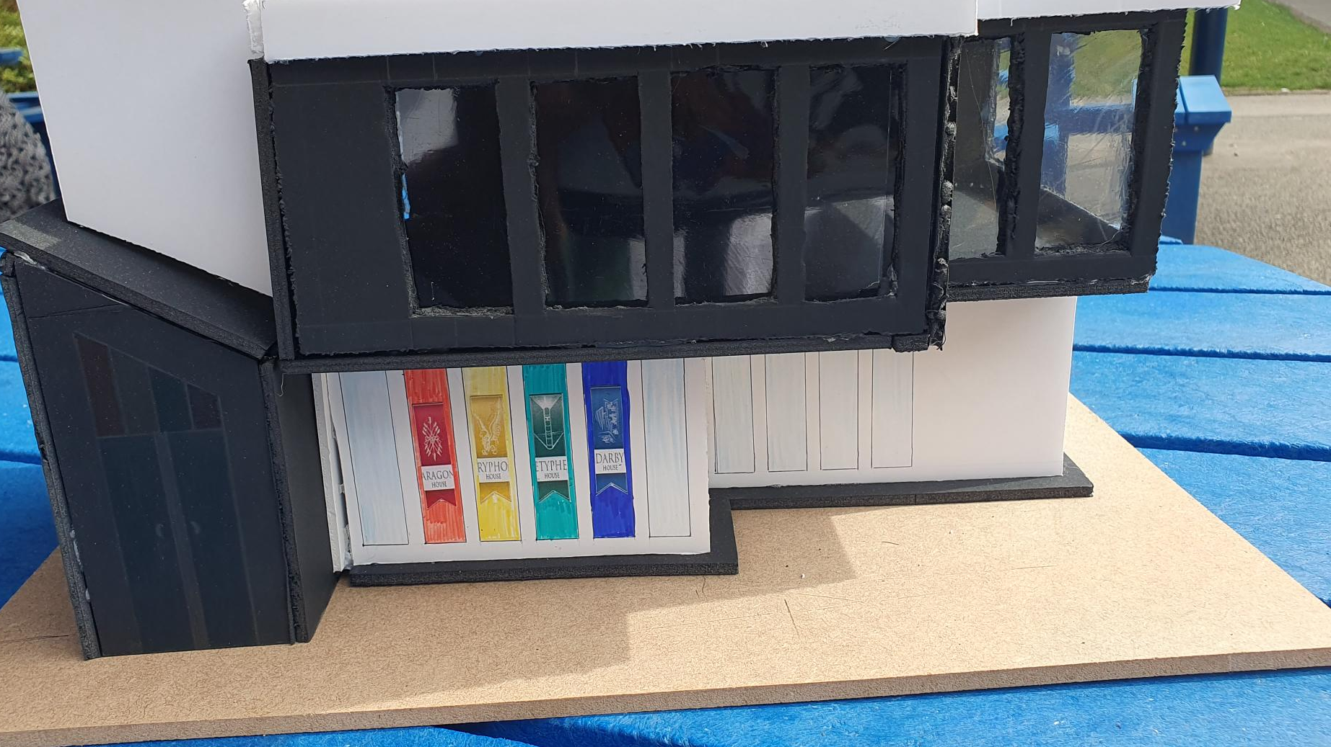
Evaluation
Now that the design is finished, I have time to evaluate how the whole process went. In terms of thinking of ideas and the process of choosing one I think it went quite well as I was able to efficiently uncover a variety of different problems that I could try to solve and chose the "Canteen Solution" with justification. When creating the Final Solutions, on CAD I found the task challenging but enjoyable, so I was able to consistently walk around problems I encountered with other solutions until I was happy with what it looked like. Although I'm a bit disappointed that I didn’t do the full idea with the extensions on the right, purely because of time, I'm still happy with how it turned out because when I encountered problems in real time I was able to find ways around it which will help in the future, like using white strips to cover the messiness or using precisely cut black pieces to fill in major gaps that I had in the model so that when it came to the final concept, I was very happy with how it ended up looking.
If I were to improve one thing however it would be the laser cut more of my pieces of foam so that the amount of messy hand-cut pieces would decrease thus contributing to a less messy, cleaner model overall.

